Slide 1
Body Art Rule and Ear-Piercing Facility Standards N.J.A.C. 8:27
Alan Talarsky, Program Manager
Public Health and Food Protection Program
New Jersey Department of Health

Slide 2
History
Initial rule “Body Art Procedures” adopted effective February 19, 2002
Readopted without change August 15, 2007
Readopted without change July 11, 2014, expires July 11, 2021
Expiration extended to June 14, 2022 due to Executive Order
Readopted without change June 14, 2022 (because it was about to expire and the amendments weren’t yet approved by NJ Office of Administrative Law)
Readopted with amendments July 18, 2022

Slide 3
Scope N.J.A.C. 8:27-1.2
1.2(a) This chapter applies to persons and entities that apply for licensure or permission to operate body art and ear-piercing establishments and operators of these establishments.
1.2(b) exempts health care providers (physicians and physician assistants).
1.2(c) this chapter has the force of law and is enforceable by the New Jersey Department of Health, other health authorities (local HDs), and State and local police pursuant to N.J.S.A. 26:1A-9.
1.2(d) implements provisions of 24:1 through 17 addressing devices and cosmetics, and 24:2-1 and 24:17-1 and 2 for enforcement

Slide 4
1.3 Definitions – new or amended
Adverse Reaction – a negative physiological response to a body art or ear-piercing procedure, such as an injury, rash, infection, or allergy.
After Care Instruction – now includes both verbal and written instructions to be provided to clients.
Areola Restoration – a body art procedure that a permanent cosmetics practitioner performs, typically following lumpectomy, mastectomy, breast augmentation surgery, and/or breast reconstruction surgery.
Camouflage – a body art procedure that a permanent cosmetics practitioner performs to restore by pigment insertion over a scar, burn, injury, etc.

Slide 5
1.3 Definitions – new or amended
Concealment – a body art procedure that a tattoo or PC practitioner performs by inserting pigments over an atypical area for the purpose of covering up that area (e.g. application of ink over an old tattoo, birthmark, etc.)
Cutting – (also known as scarification) means creating a design by cutting skin or other soft tissue to leave a scar, using acid, a sharp blade, a knife, or another chemical, implement, or device the manufacturer of which neither designed nor intended for the purpose of performing body art. Excludes microblading.
Ear Piercing – now includes earlobe piercing/prohibits high-impact piercing machines for piercing the trailing edge (cartilaginous) of the ear.

Slide 6
1.3 Definitions – new or amended
Health Care Provider – means physicians and physician assistants.
Microblading – the definition in the National Environmental Health Association’s Policy Statement is adopted by reference.
Operator – in addition to the owner, now includes a person, designated by the owner of the body art establishment, who has control over the day-to-day management over the establishment.
Permanent Cosmetics – means the intradermal implanting of inert pigments, colors, and/or dyes, which results in permanent alteration of tissue to gain a cosmetic effect, and includes microblading.

Slide 7
1.3 Definitions – new or amended
Pigment – means “color additive” as 21 CFR Part 70, particularly at § 70.3, defines that term.
Responsible Person – like a PIC, a practitioner trained in the obligations and duties of an operator when the operator is not present in the body art establishment
Single-Use Items – lists various articles to be used once and then discarded. Now includes markers.

Slide 8
1.3 Definitions – new or amended
SofTap Inc. – a Livermore, CA firm that offers a 100-hour basic permanent cosmetic course accepted by the Department for training. Currently, their curriculum includes 3 practical procedures on eyebrows, eyeliners, and lips. Therefore, individuals who successfully pass this course and practitioner’s exam must still obtain an additional 2 procedures of each type in an apprenticeship under the supervision of a trainer or instructor of permanent cosmetics.
Trainer or Instructor of Permanent Cosmetics - Trainer or instructor of permanent cosmetics” means a permanent cosmetics practitioner holding one or more of the following credentials: 1. American Academy of Micropigmentation Board Certified Platinum Trainer; 2. Society of Permanent Cosmetic Professionals Trainer Membership; or 3. SofTap®, Inc., Trainer

Slide 9
Subchapter 2 Administration – new and amended sections
2.1(b)4 Written client consent forms must be submitted with each body art establishment license application
2.6(a)2 Prohibits laser removal of pigment in a body art establishment. Laser removal can only be performed by a health care provider.
Subchapter 3 – Physical Plant and Environment - no changes

Slide 10
Subchapter 4 Client and Occupational Health and Safety – New name! With new and amended sections
4.4(a) The requirement to obtain a written agreement with a physician has been eliminated. However, practitioners performing areola restoration or camouflage procedures must do so in accordance with written instructions from a client’s health care provider and maintain these instructions with the client consent form.
4.6(a) Operators must maintain records of adverse reactions when notified by clients, then notify the local health authority by phone or in-person within 24 hours, then notify local health authority in writing (email, fax, etc.) within 2 business days.
4.7(c) Alternatives to latex medical gloves must be supplied at each establishment.

Slide 11
Subchapter 4 Client and Occupational Health and Safety – New name! With new and amended sections
4.7(e) Workers with suspected or confirmed communicable disease may not be present in the establishment and must have written documentation from health care provider permitting them to return to work. Does not apply to persons with the bloodborne diseases Hepatitis B, Hepatitis C, and HIV.
4.8 Requires all apprentices and practitioners to have bloodborne pathogen training. Requires operators to provide BBP training at their expense and during employees’ work hours.
4.9(a) Requires pigments to be non-toxic and non-carcinogenic.

Slide 12
Subchapter 4 Client and Occupational Health and Safety – new name & with new and amended sections
4.9(b)3 Requires the recording of the pigments used for each procedure, including the lot number of each pigment, in the client record of the procedure.
4.9(b)4 Pigment removal solutions must have labels that list their ingredients, including percentages of active ingredients, measure of pH, preservatives, and directions for use.
Subchapter 5 – Sterilization and Disinfection – no changes

Slide 13
Subchapter 6 Body Piercing
6.1(a)1 Acceptable documentation for body piercing training and experience – tax/payroll records, references from former employers, certificates/diplomas of completion of apprenticeship, membership in the APP or other professional organization
6.1(a)2 In addition to at least 10 photographs of piercings personally performed, at least 10 former client applications must be provided.
6.1(b) 1,000-hour apprenticeship under the direct supervision of a practitioner.

Slide 14
Subchapter 6 Body Piercing
6.2(a)1 All piercing jewelry must be compliant with the Alliance of Professional Piercers’ Initial Jewelry Standards.
6.2(a)2 All piercing jewelry shall be sterilized or disinfected.
6.2(a)3 If not immediately used after disinfection, jewelry shall be placed in a heat-sealed or zipper-topped plastic bag.
6.2(a)4 Jewelry designated for certain parts of the body by the manufacturer shall not be applied to other parts of the body.

Slide 15
Subchapter 6 Body Piercing
6.2(a)5 If previously worn by anyone other than the client, the jewelry shall be cleaned and autoclaved and the operator shall ensure that the client receives written notice of the jewelry’s pre-worn status before use

Slide 16
Subchapter 7 Tattooing
7.1(a)1 Acceptable documentation for tattooing training and experience – tax/payroll records, references from former employers, certificates/diplomas of completion of apprenticeship, membership in the APT or other professional organization.
7.1(a)2 In addition to at least 10 photographs of tattoos personally performed, at least 10 former client applications must be provided.

Slide 17
Subchapter 8 Permanent Cosmetics
8.1(a) Clarifies that performing 5 eyebrow, 5 lip line or shading, and 5 eyeliner or eyelash enhancement with pigments (not extensions – that is a cosmetology procedure) are required to be qualified as a practitioner.
8.1(b) Basic permanent cosmetic courses shall be at least 100 hours in duration, which American Academy of Micropigmentation (AAM), Society for Permanent Cosmetic Professionals (SPCP), and SofTap courses all are. Apprentices must pass an examination administered by one of these organizations.
8.1(c) The experience requirement (5 of each type of procedure above) may be accepted if obtained in a state or country where AAM, SPCP, or SofTap training is not required. HOWEVER, the applicant must still pass one of the practitioner examinations in 8.1(b) and perform one additional of each type of procedure under the direct supervision of a trainer or instructor of permanent cosmetics and document in clients application along with corresponding photograph.

Slide 18
Subchapter 8 Permanent Cosmetics
8.1(d) Areola restoration practitioners must successfully complete a 16-hour training program in areola restoration.
8.1(e) Camouflage practitioners must possess the credentials of a general permanent cosmetics practitioner, have completed at least 6 months of experience, AND successfully complete a 16-hour training program in camouflage.
8.2 Establishes apprentice program requirements. They must be taught by trainers or instructors of permanent cosmetics and documented. Allows for no more than 4 apprentices per trainer and no more than 1 apprentice performing a procedure per trainer at any one time.

Slide 19
Subchapter 9 Ear Piercing
9.1 Establishments that perform any ear piercing, including ear lobe only, shall be licensed and inspected by the local health authority.
9.3(b) Establishes the requirements of the client consent form for ear piercing.
9.3(d) Minors, other than emancipated minors, must have parent/guardian present, with ID, and provide written consent.
9.5(c) Hand sanitizer is permitted if there are no handwashing sinks readily available (e.g. piercing kiosks in shopping malls, etc.). Otherwise, permanent establishments shall have handwashing sinks as per 3.1(e).

Slide 20
Subchapter 11 Enforcement
Subchapter 10 – Temporary Establishments - no changes
11.2(a) All body art and ear piercing establishments must be inspected at least once per year.
11.2(c) Provides right of health authority to access and inspect premises, records, equipment, etc.
11.2(d) Operator shall permit a health authority to have full access to the establishment and its pertinent records.

Slide 21
Subchapter 11 Enforcement
11.2(g) Operators must submit a written (can be email, fax, etc.) plan of corrective action, for all violations identified by the health authority, within 10 business days.
11.2(h) The health authority shall accept or reject, in writing, a plan of corrective action within 10 business days of receipt of the plan.
11.2(i) The health authority may conduct a reinspection to verify corrective actions.
11.2(j) Operators are subject to additional or enhanced enforcement action for failure to timely pay assessed fines and/or penalties; submit a plan of correction; or complete corrective actions in accordance with an accepted plan of correction action and timeframe.

Slide 22
Subchapter 11 Enforcement
11.3(a) and (b) Provides greater enforcement authority to local health authorities to close establishments, as well as for taking action against unapproved persons performing body art. List examples of conditions that pose an actual/imminent threat to public health that warrant immediate closure.
11.3(c) Provides examples of actual or imminent hazards that warrant at least a 7-day suspension of an operator’s license or permit.
11.4 Titles 24 and 26 are adopted by reference. Provides for greater enforcement to health authorities – 24 includes cosmetics and devices.
11.5 Empowers health authorities to take enforcement action on adulterated and misbranded devices and cosmetics.

Slide 23
Subchapter 11 Enforcement
11.2(k) Local health authorities shall report to NJDOH, in January of each year, each adverse reaction notification received pursuant to N.J.A.C. 8:27-4.6 and each suspected or confirmed case of a reportable communicable disease or outbreak pursuant to N.J.A.C. 8:57.
11.2(l) Government records subject to public access: final reports of annual inspections of body art and ear-piercing establishments, reports of inspections of temporary establishments, plans of correction, and a final report of an outbreak epidemiological investigation of or related to a body art or an ear-piercing establishment.
11.2(m) Government records not subject to public access: reports of an adverse reaction notification, communicable disease reports, records relating to an outbreak epidemiological investigation of a body art or an ear-piercing establishment.

Slide 24
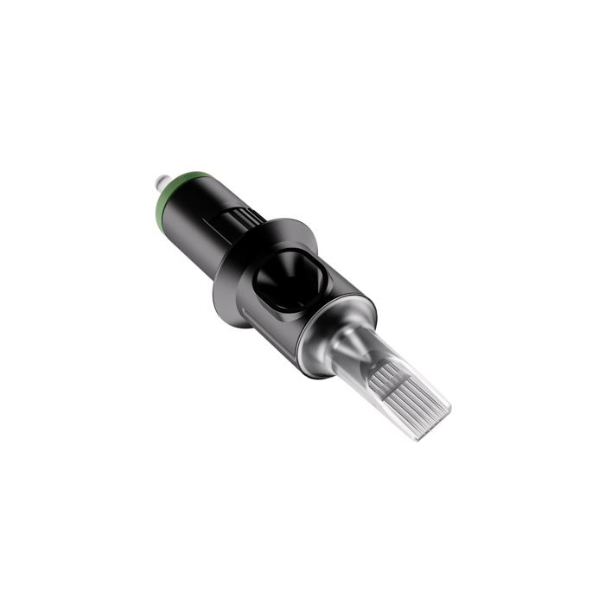
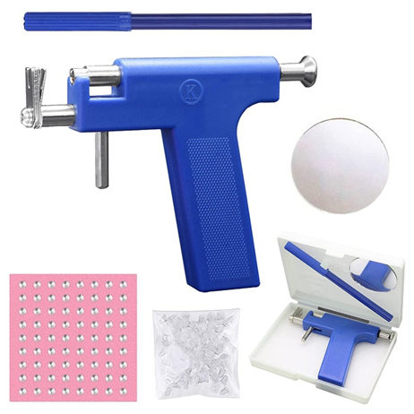
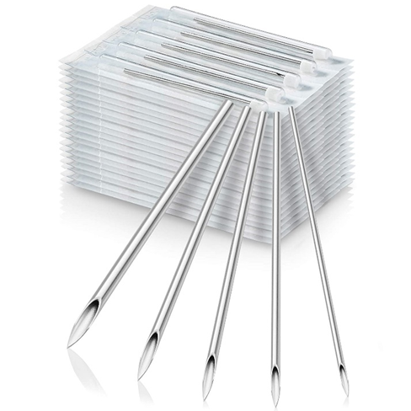
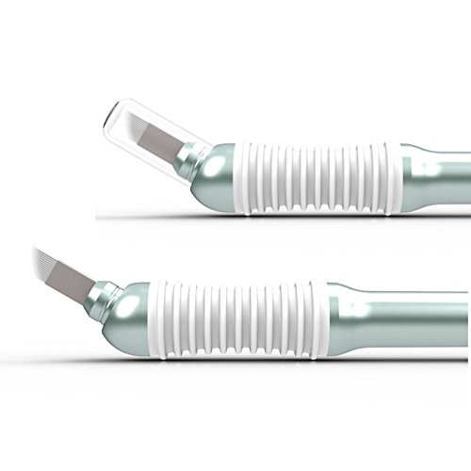
Thank you – Questions and Answers

